Slide 1
Best Rent: A Car Rental System
CS 411 Project
Group 11
Tianyi Bao, Xiang Li, Zijie Li, Zhangde Song
GitHub: https://github.com/lzivan/CS411_Project

Slide 2
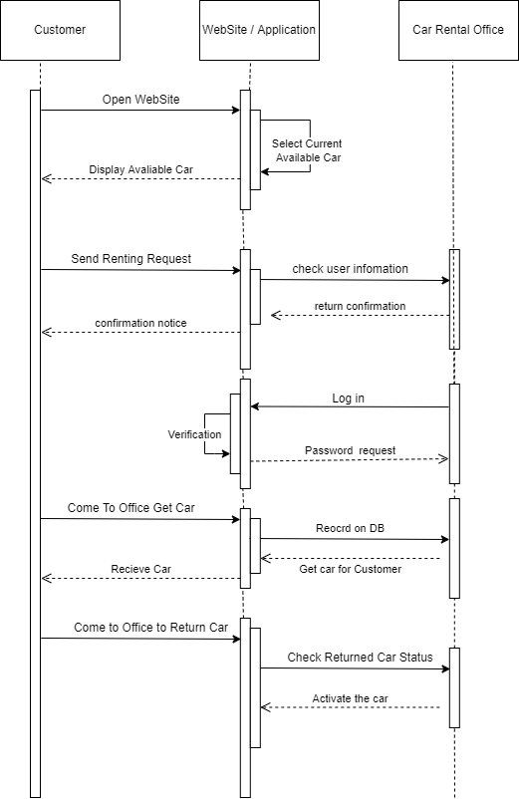
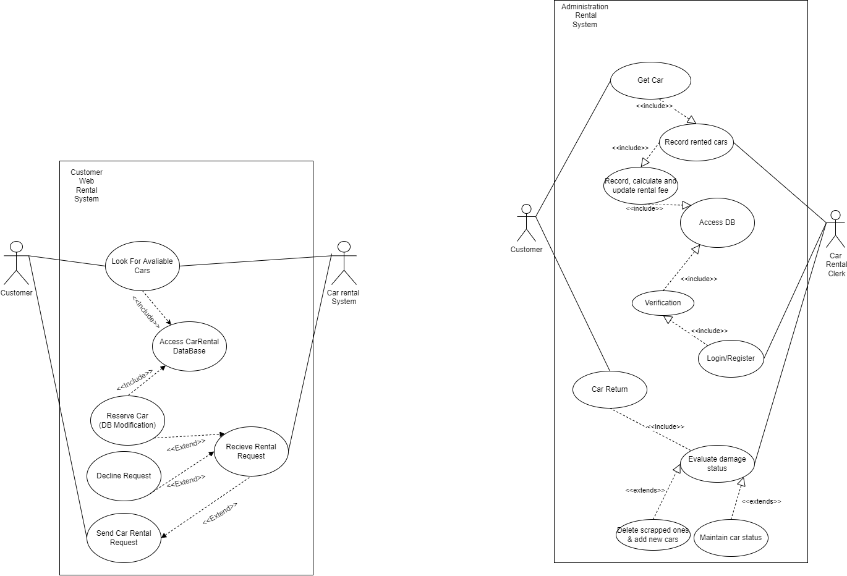
Problem Definition and Capabilities
We design this car rental system which will allow car rental companies to record customers’ information and manage the stock information. Also, customers can use this system to check which kind of car is available for rent and send their order.
Use Case Diagrams
Detailed Sequence Diagrams

Slide 3
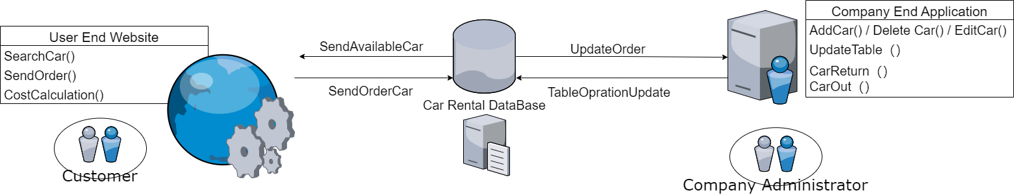
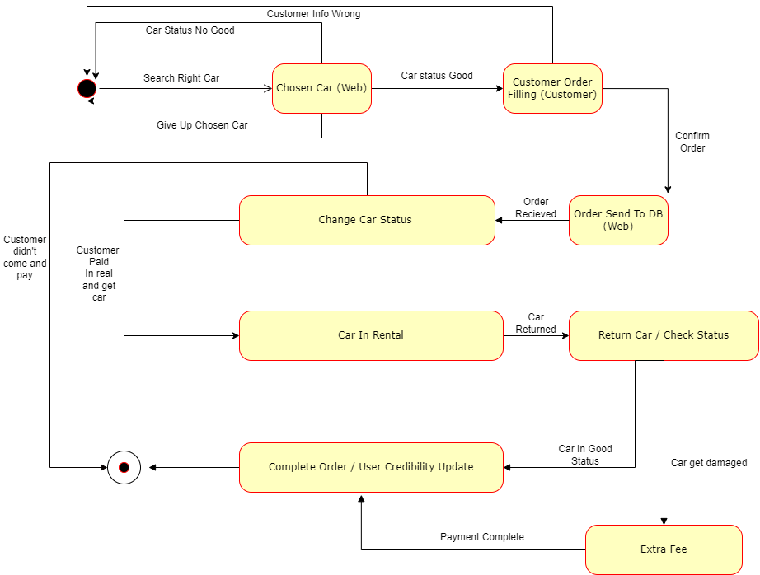
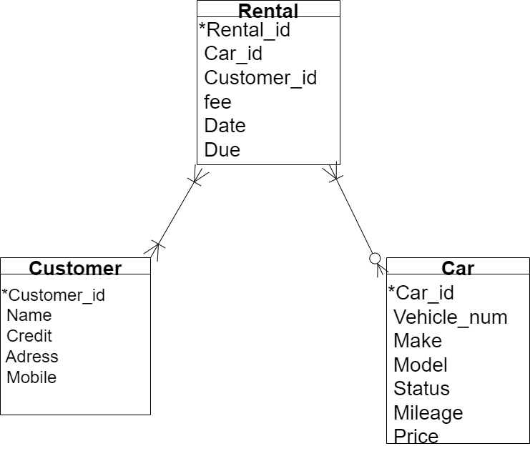
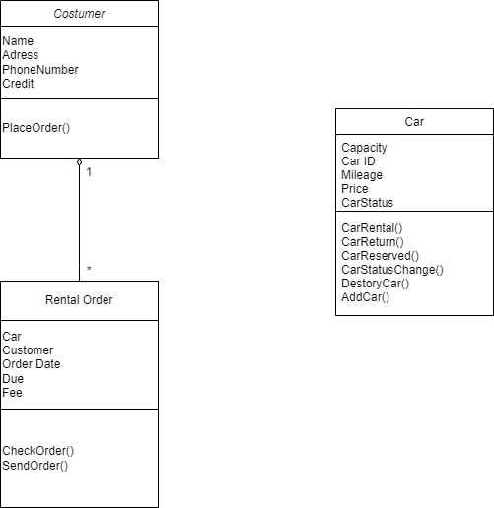
Application Architecture and Structure
State Machine Diagrams
Class Diagram
ER-Diagram

Slide 4
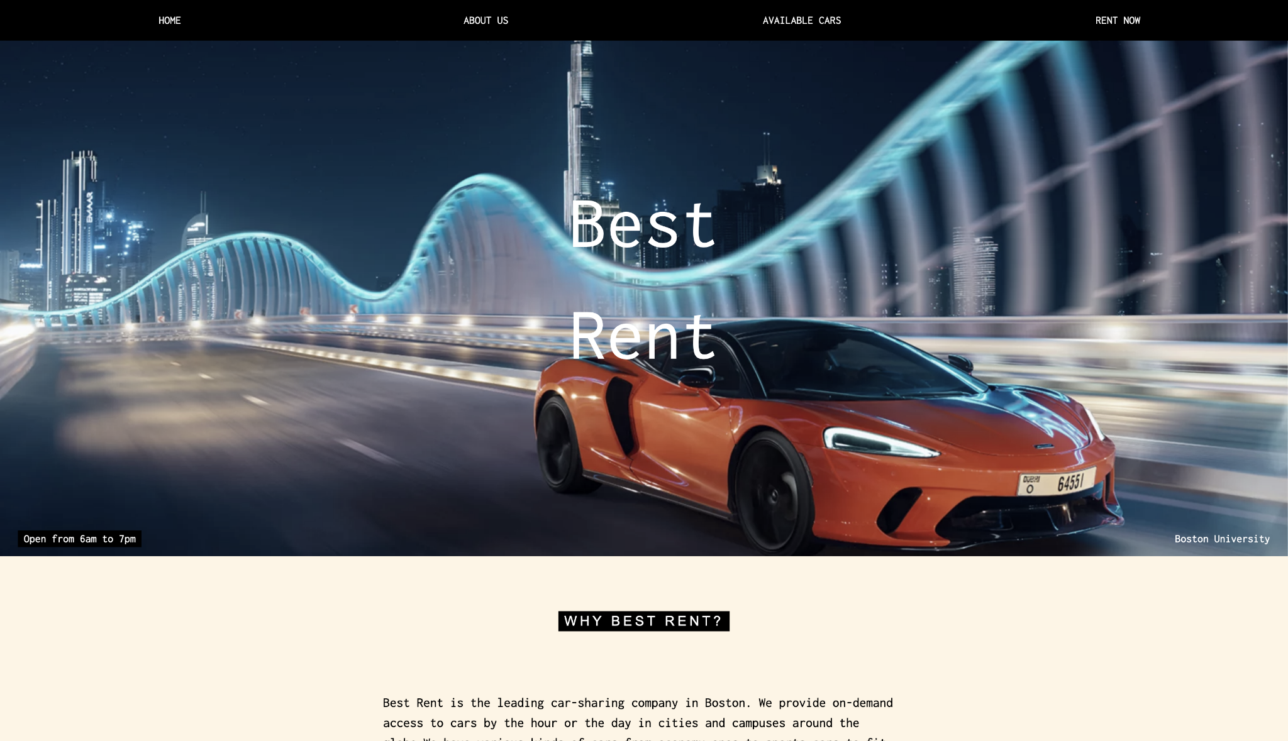
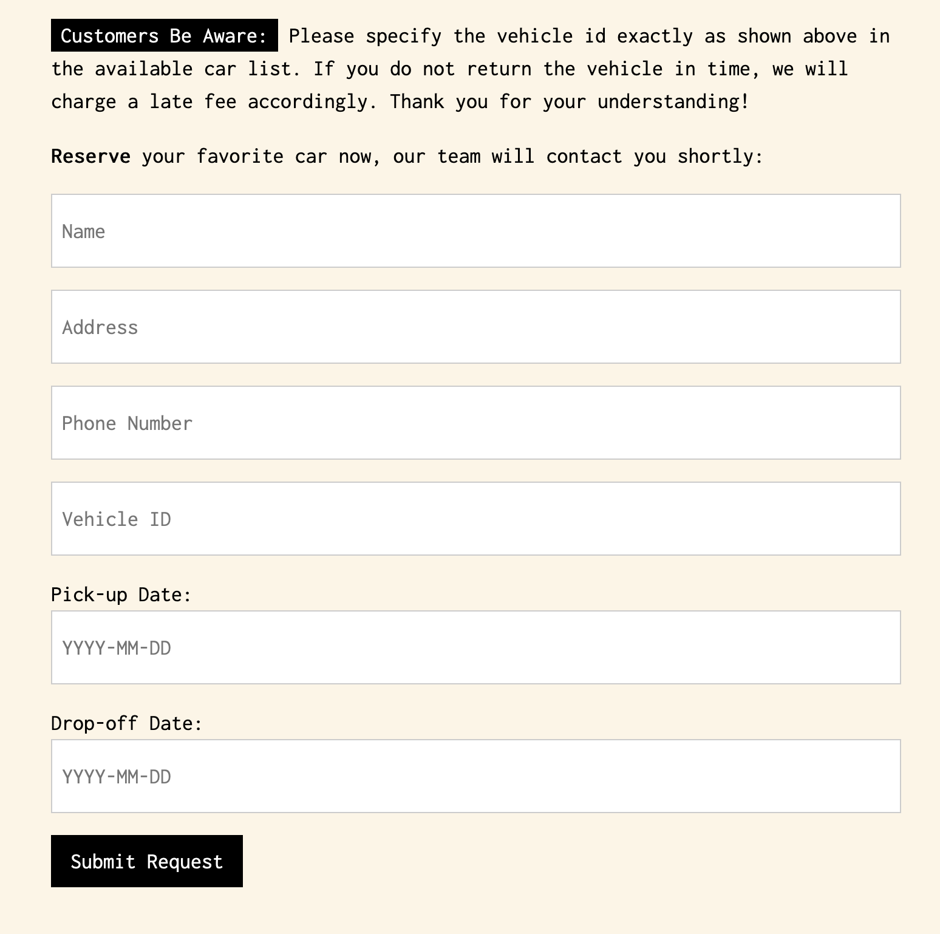
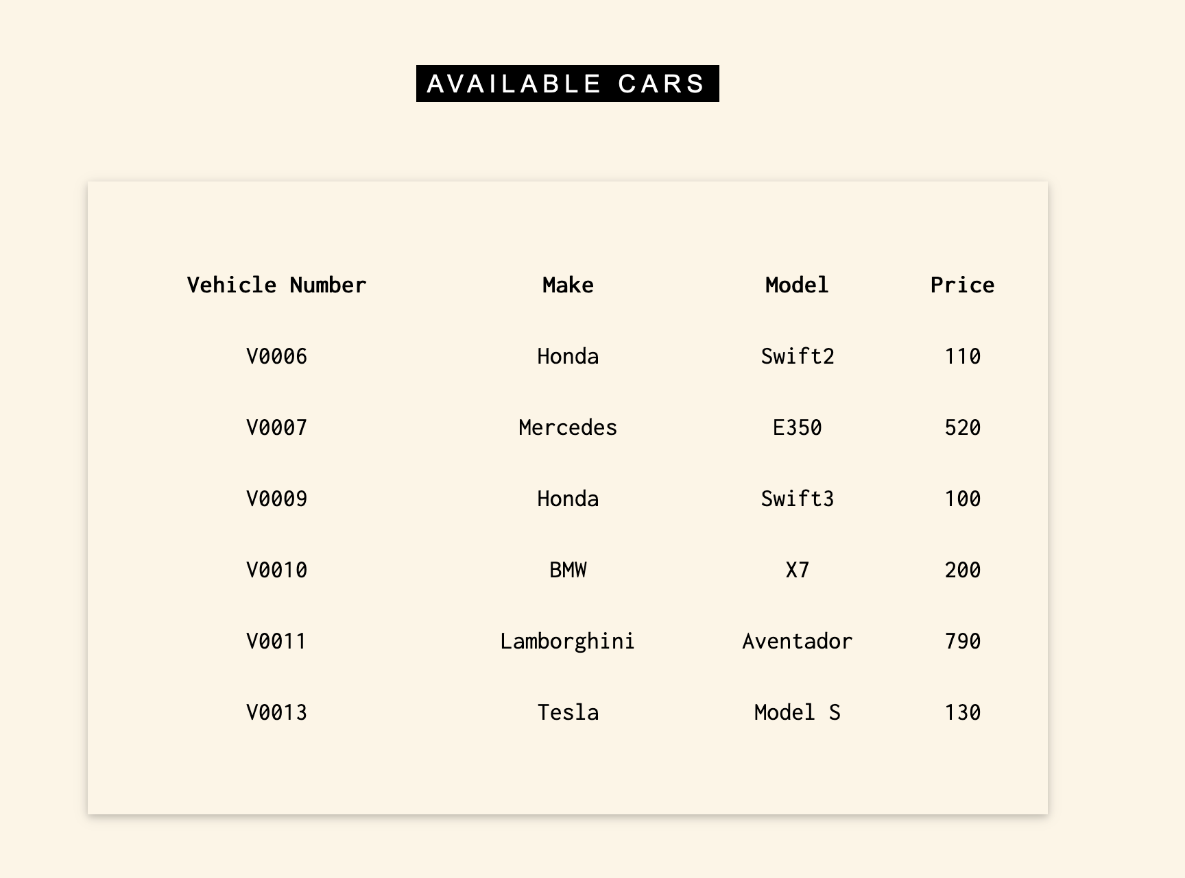
How Does Our Application Work?
Notes:
This is our customer side user interface. It is web based with a user friendly design so that customers can navigate through what vehicle is available and at the end of the page there is a form for customers to fill. When user submit the request, the customer and rental information will be sent to the database, and in the company terminal, employees can see the status so that they can make further contacts with the customer.

Slide 5
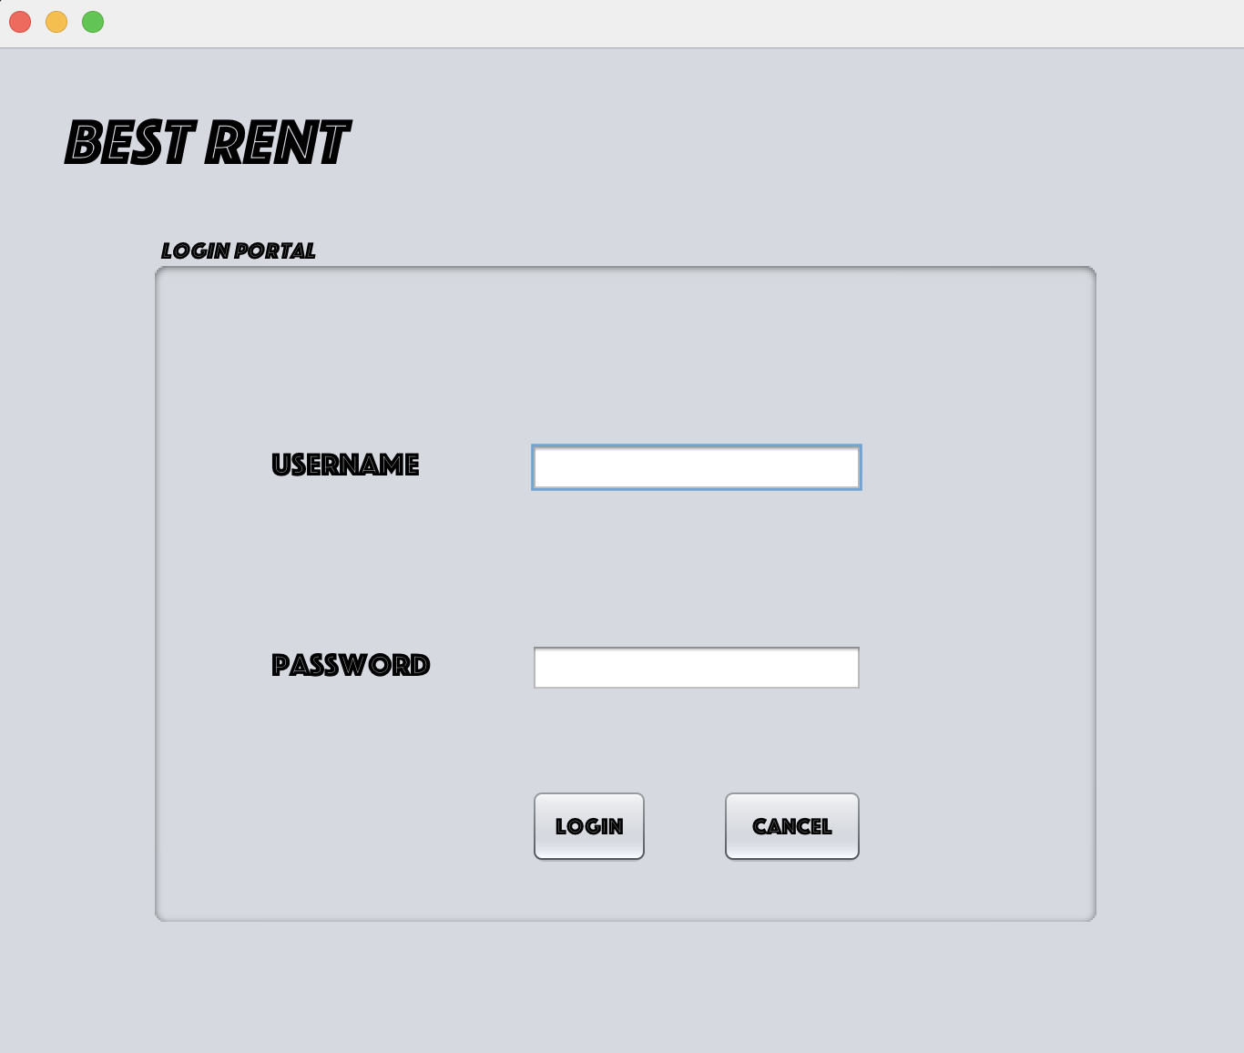
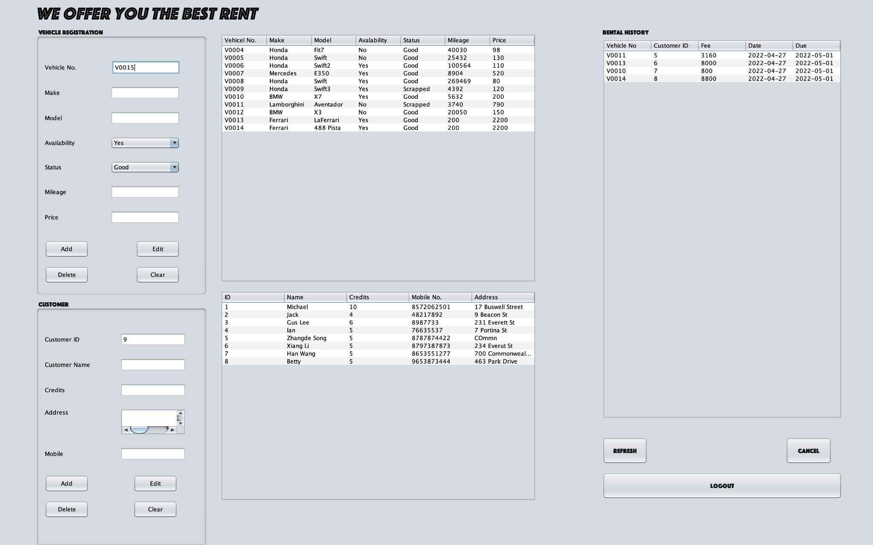
How Does Our Application Work?

Slide 6
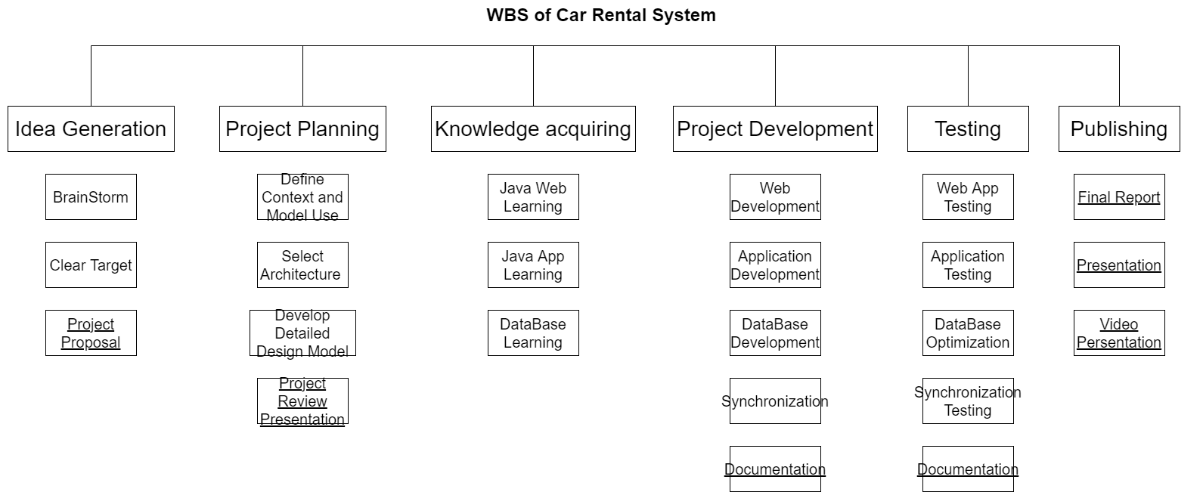
What We Learned
Notes:
Throughout this assignment, our team members learned a lot.
From a skill point of view, we learned java application development especially in Java GUI design and how java interact with SQL database using JDBC. We have also learned how to do web based programming such as html and how java can be embedded.
Furthermore Pattern design , Architecture
We also learn a lot in project management.
We need to a flex schedule for unpredictable accident and members should communicate well on each steps.

